Slide 1
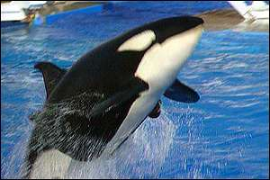
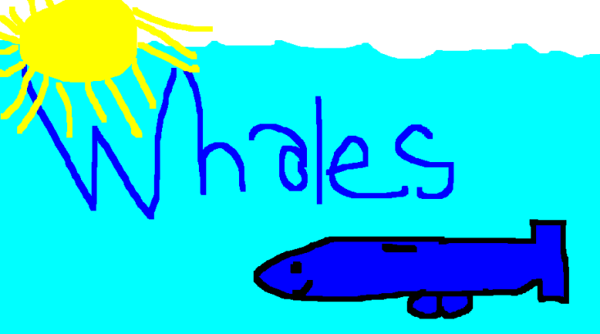
Whales
By: Avery French

Slide 2
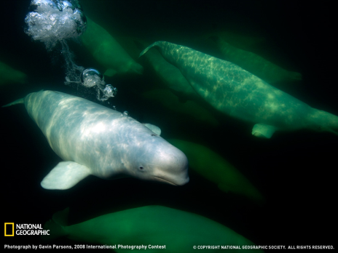
Why whales can’t die!!!!
We love whales
We enjoy whales
We want whales
Also because without whales there will be not oil, lipstick, or A LOT of make-up.
We want whales to live forever and not stop at the year 2010.

Slide 3
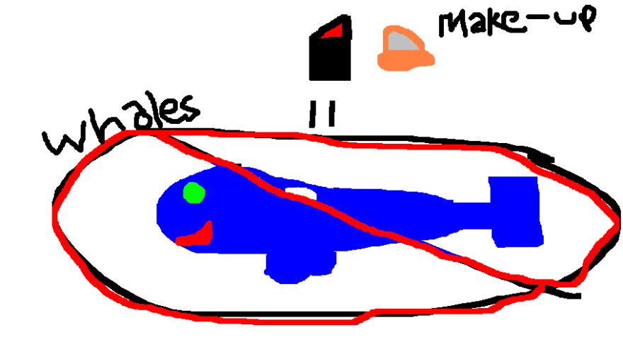
Why should you care!!!!!!
You should care cause the whales give oil, lipstick, and a lot of make-up.
You should Stop buying make-up/restocking them you are just killing more and more whales but if you have to where make-up buy oil free make-up PLEASE do it will save A LOT more whales.

Slide 4
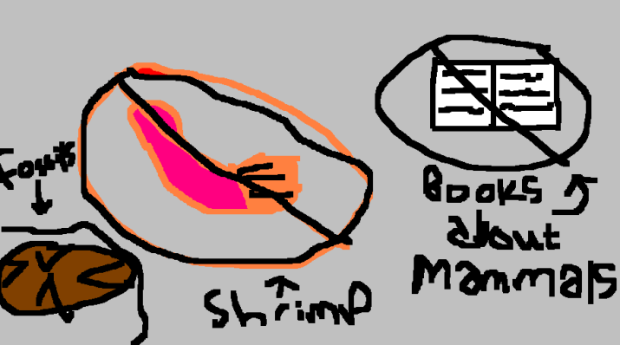
Why should you take my word?!?
I think y0u should take my word because I have been a whale information girl since 2nd grade and I know A LOT about whales!!!!!!
Also because I am trying to help you!!!!!!
AND if you don’t care then this will happen no seafood, no studying your favorite mammal, and A LOT of fossils in the place you swim in at the beach.

Slide 5
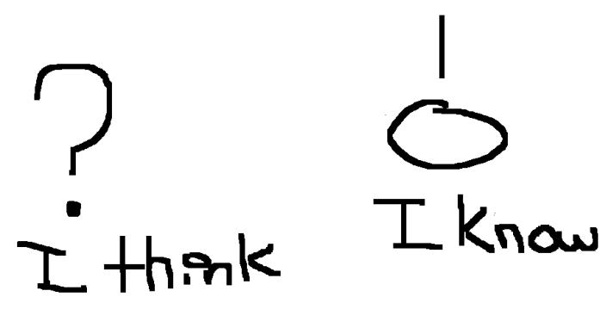
I think…….. Or I know?!?!
I know that if we don’t save the whales soon the whales will come extended and I will not be happy if Shamo is die before I ever get to see him/her.
I think we should just think about how much we spend on make-up and see the difference in buying and not buying.
I KNOW what I am talking about when I’m talking about whales.

Slide 6
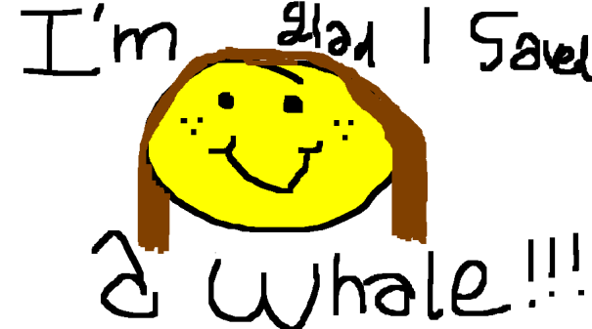
Contact Information
If you want t0 contact me about the sideshow or about whales e-mail me at French.Avery@gmail.com
PLEASE WHALES NEED TO BE FREE!!!!!!
THINK WHAT IF WE WERE THE WHALES GOING TO BE EXTENDED BECAUSE OF WHAT WE ARE THAT’S NOT FAIR SO SAVE A WHALE IT WILL SAVE THE SEA AND YOU WILL BE GLAD YOU DID IT.

Slide 7
THE END But please help the whales they need you
By: Avery French
They want your help always!!!!!!!!!

